Slide 1
SCRIPT ANALYSIS
This project introduces a comprehensive tool for analysis and evaluating programming code, focusing on metrics that provide insights into its structure, complexity, and quality.
NAME : ADHIVEL V
CLASS & SECTION : III-B
DEPARTMENT : BCA
ROLL NO. : 60702
REG NO. :2213141033052

Slide 2
Project Description
The Code Analysis Tool is a web-based application that provides comprehensive static code review, formatting, and analysis. Supports multiple programming languages. It helps developers understand code structure, complexity, and quality metrics through an intuitive interface. . This system serves developers, teams, and organizations by providing automated code formatting, quality assessment.

Slide 3
Purpose
Standardize code formatting across teams
Reduce manual code review time
Ensure coding standards compliance
Improve code quality and readability
Facilitate easier code maintenance

Slide 4
Proposed System
1
Code Input Methods
2
Analysis Capabilities
Direct code pasting
Syntax validation
File upload
Code metrics calculation
Drag and drop support
Complexity analysis
Structure identification
Pattern recognition
3
Result Presentation
Visual metrics display
Detailed breakdowns
Interactive components
Exportable reports

Slide 5
System Requirements
Minimum Requirements:
OS: Windows 7, macOS 10.12, or Ubuntu 18.04
Processor (CPU): 1 GHz Dual-Core
RAM: 2 GB
Storage: 200 MB Free Space
Graphics: Integrated Graphics
Internet: 1 Mbps
Recommended Requirements:
OS: Windows 11, macOS 12, or Ubuntu 22.04
Processor (CPU): Intel Core i5 / AMD Ryzen 5 or equivalent
RAM: 8 GB or more
Storage: 500 MB Free Space
Graphics: Dedicated GPU (e.g., NVIDIA GTX 1050)
Internet: 10 Mbps or higher

Slide 6
System Specification
1. Hardware Specifications
2. Software Specifications
3.Performance Specifications
1.1 Server Requirements
2.1 Development Stack
3.1 Response Times
Processor: Multi-core CPU (2+ cores)
Frontend:
File Upload: < 5 seconds
RAM: 4GB minimum
HTML/CSS
Code Analysis: < 3 seconds
Storage: 256GB SSD or HDD
JavaScript
Code Formatting: < 2 seconds
Network: 1Gbps Ethernet
Monaco Editor
Loading: < 5 seconds
1.2 Client Requirements
Backend:
3.2 System Capacity
Modern web browser (Chrome, Firefox, Safari, Edge)
Python 3.8+
Concurrent Users: 1000+
Flask 2.0+
File Size Limit: 10MB
Minimum 4GB RAM
Radon
Request Rate: 100/minute per user
Stable internet connection (5Mbps+)
Total Storage: 500GB expandable
Development Tools:
Display resolution: 1280x720 minimum
Git
VS Code/PyCharm

Slide 7
Key Features:
1. Code Input Methods
2. Analysis Features
3. Formatting Capabilities
File Upload System
Style Checking
Code Structure
Support for multiple file formats
Language-specific style guides
Line length management
Batch processing capability
Custom rule configuration
Bracket placement
Direct Code Paste
Team standard enforcement
Comment alignment
Real-time syntax highlighting
Language auto-detection

Slide 8

Target Users: Empowering Developers
1
Individual Developers
Students, freelancers, and open-source contributors benefit from improved code quality and efficiency.
2
Development Teams
Software engineering teams, code reviewers, and project managers streamline workflows and enhance collaboration.
3
Educational Institutions
Programming instructors, students, and teaching assistants gain valuable insights and tools for learning and teaching.

Slide 9

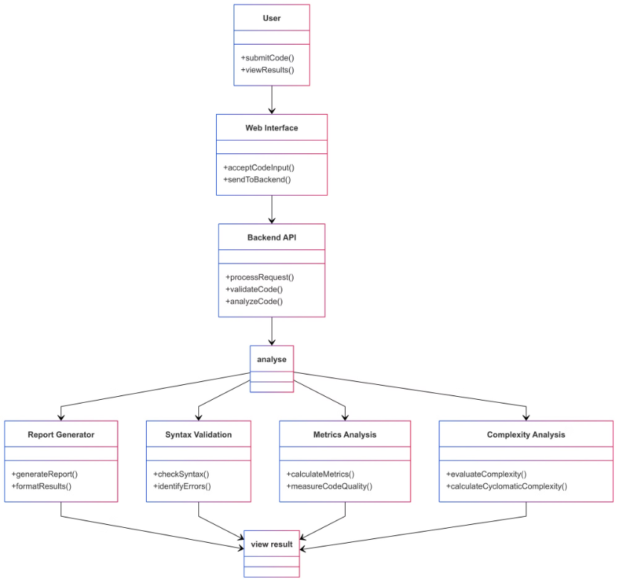
System Design Diagram

Slide 10

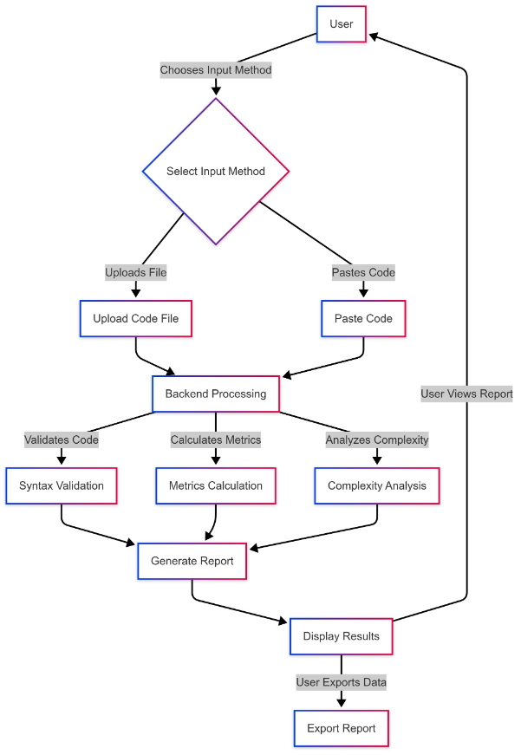
Data Flow Diagram (DFD)

